Slide 1
Final Project 3
UIUC ECON 490: Applied Machine Learning in Economics

Slide 2
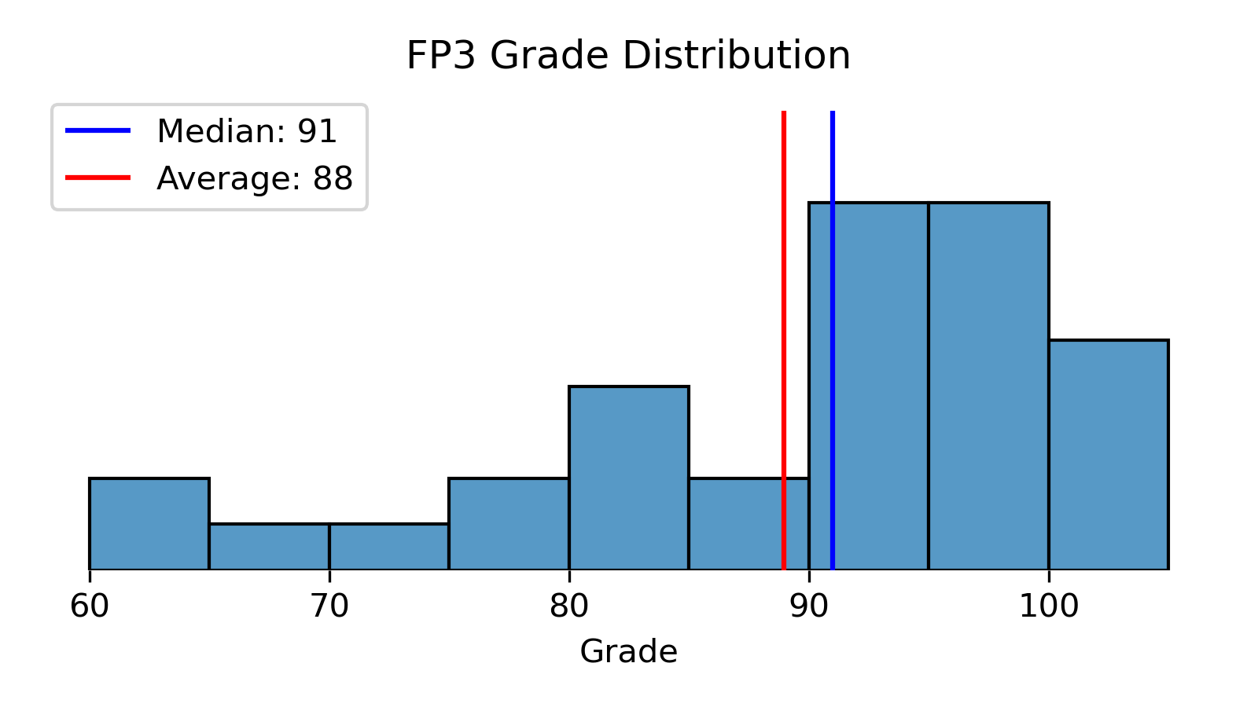

Slide 3
Cross-validation
Tuning hyperparameters

Slide 4
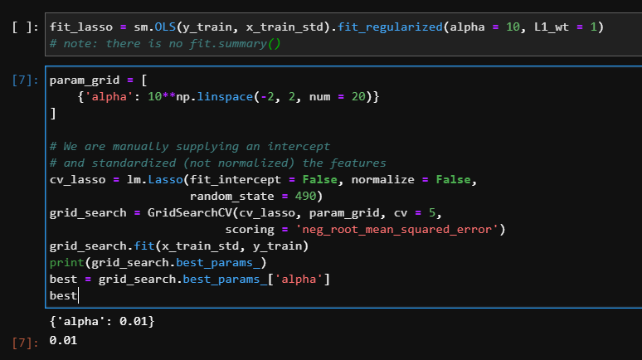
lm.Lasso() is for regression, not classification

Slide 5
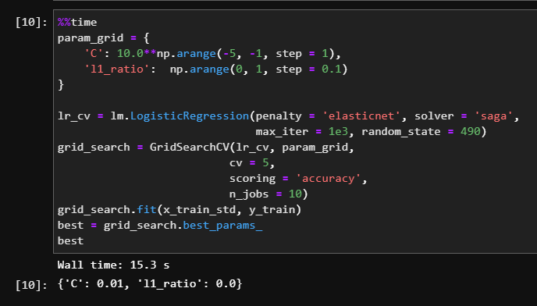
Is C an interior solution? Poll…

Slide 6
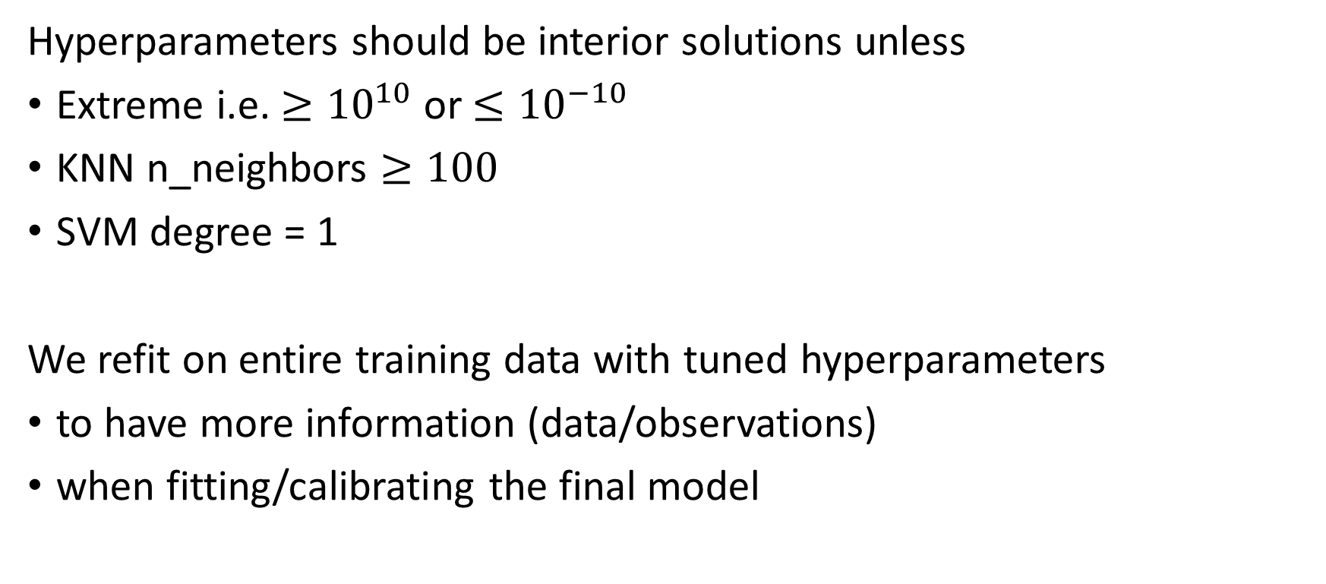
CV Notes
Hyperparameters should be interior solutions unless
Extreme i.e. $≥{10}^{10}$ or $≤{10}^{−10}$
KNN n_neighbors $≥100$
SVM degree = 1
We refit on entire training data with tuned hyperparameters
to have more information (data/observations)
when fitting/calibrating the final model

Slide 7
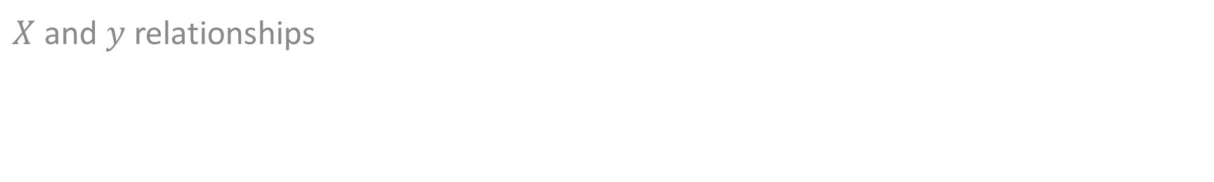
Inference & Interpretation
$X$ and $y$ relationships

Slide 8
Are these marginal effects? Most significant coef?
fit = smf.logit(formula = 'full_time ~ l_incwage + experience', data = df).fit()
print(fit.summary())
==============================================================================
coef std err z P>|z| [0.025 0.975]
------------------------------------------------------------------------------
Intercept -15.2296 0.045 -342.030 0.000 -15.317 -15.142
l_incwage 1.6557 0.005 362.421 0.000 1.647 1.665
experience 0.0005 0.000 1.804 0.071 -4.15e-05 0.001
==============================================================================
If this was a regression, these are the marginal effects.

Slide 9
INTERPRETING marginal effects
fit.margeff().summary()
==============================================================================
dy/dx std err z P>|z| [0.025 0.975]
------------------------------------------------------------------------------
l_incwage 0.1608 0.000 501.339 0.000 0.160 0.161
experience 4.652e-05 2.58e-05 1.804 0.071 -4.03e-06 9.71e-05
==============================================================================
A one percent increase in wages is associated with an increase in the probability of being full time by 16 percentage points

Slide 10
Interpretation is inference: X&y relationships
Easiest to interpret model:
Decision-tree
Then
OLS
You cannot interpret RF, SVMs, KNN, etc.
ML does not estimate causal relationships.

Slide 11
Interpretation is inference: X&y relationships
ML does not estimate causal relationships.
An increase in l_incwage does not cause full time status to change;
their movement is associated with one another.

Slide 12
Train-test splits
The right number of training observations, not percentage of all data

Slide 13
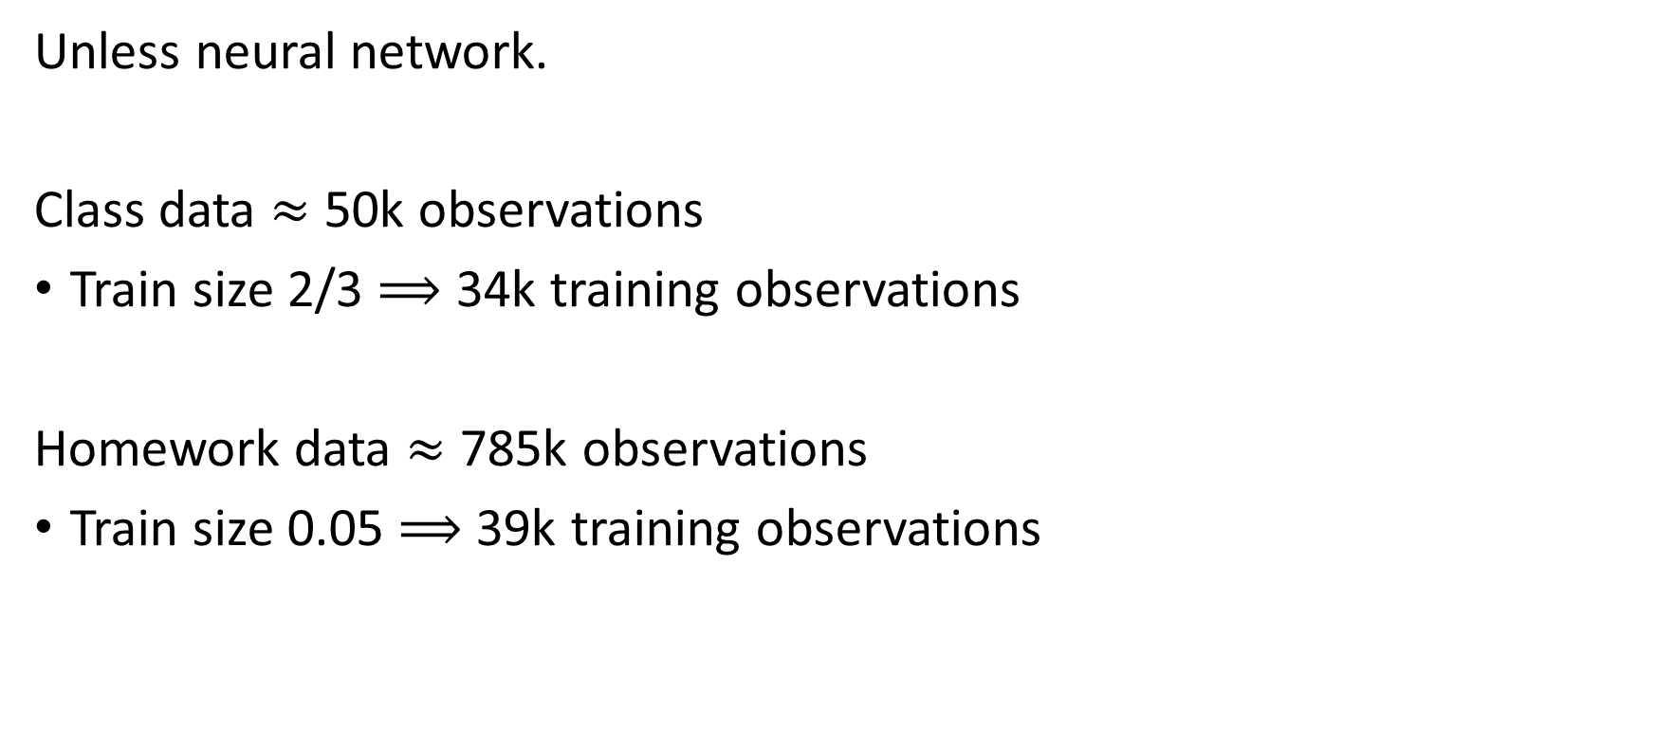
Rule of thumb: 10k-100k training observations
Unless neural network.
Class data $≈$ 50k observations
Train size 2/3 $⟹$ 34k training observations
Homework data $≈$ 785k observations
Train size 0.05 $⟹$ 39k training observations

Slide 14
The silly mistakes
COVID blues?

Slide 15


Sklearn.module.model.score()
Regression – continuous label ($y$)
$R^{2}$, not RMSE
Classification – categorical label ($y$)
Accuracy

Slide 16
If regression problem (continuous label)…
Don’t use RandomForestClassifier()
Use RandomForestRegressor()

